Slide 1
AIRLINE PROJECT
Submitted By – Ayushi(2823843)
Submitted to-
Mr. Abhishek

Slide 2
01
Objective/Aim/Goal
1
02
Literature Review
CONTENTS
2
03
Design/Models used in SDLC
3-4
04
Implementation with screenshots
5-6
05
Conclusion/Future Scope
7
06
Bibliography
8

Slide 3
01
Objective of the Project
The goal of passenger satisfaction in an airline project centers on improving the overall experience of travelers by addressing multiple factors that influence their perception of quality, comfort, and service throughout their journey.

Slide 4
LITERATURE REVIEW
Numerous studies, such as Parasuraman et al.’s SERVQUAL model (1985), have examined how airlines measure customer satisfaction. More recent work emphasizes digital customer engagement through mobile apps and online services, like the study by Amadeus (2016) on customer personalization.
One area of focus is how airlines utilize FFP to build loyalty and manage customer relationships. Research by Uncles et al. (2003) delves into the effectiveness and strategic use of these programs for retaining customers.
As technology evolves, passengers increasingly expect advanced in-flight entertainment (IFE) systems and reliable Wi-Fi. Kim and Lee (2011) found that entertainment and internet access can enhance satisfaction, particularly on long-haul flights.
In-flight meal quality is another important driver of satisfaction. According to research by Han and Hyun (2018), passengers place high value on meal options, particularly when they are freshvaried, and accommodate different dietary preferences.

Slide 5
DESIGN/MODELS USED IN SDLC- 1
In this project , we used the agile model.
The Agile model is one of the most widely used methodologies in projects focused on customer satisfaction, as it allows for frequent updates, continuous feedback, and rapid iterations based on user input. For a project centered on airline passenger satisfaction, Agile provides the flexibility to:
Quickly adapt to passenger feedback.
Roll out frequent updates (such as app features or loyalty program changes).
Continuously improve passenger touchpoints like mobile apps, in-flight entertainment systems, and
customer support platforms.
Use Case:
Enhancing a mobile booking app by releasing frequent updates based on real-time feedback from passengers.
Implementing personalized features in the loyalty program (e.g., frequent flyer programs) with flexibility to change based on user preferences.

Slide 6
DESIGN/MODEL USED IN SDLC-2
Benefits:
Flexibility to incorporate customer preferences in real time.
Ability to prioritize key features (like baggage tracking, seat upgrades, or customer service improvements).
Challenges:
Requires strong team collaboration and may lack structure for large, complex systems like an entire airline management platform.

Slide 7
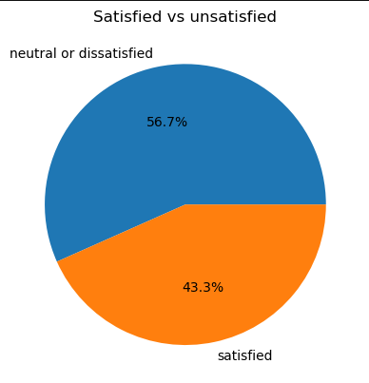
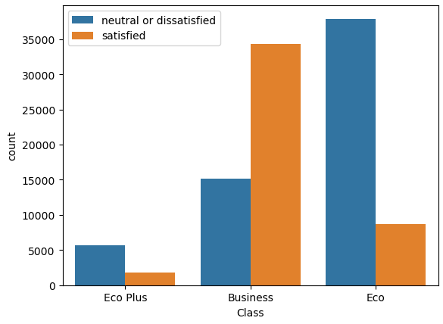
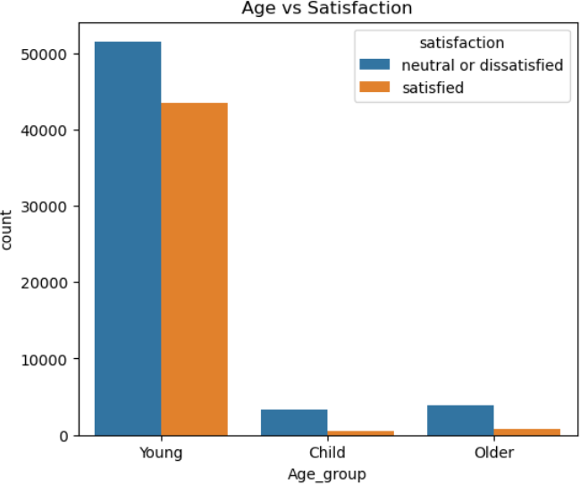
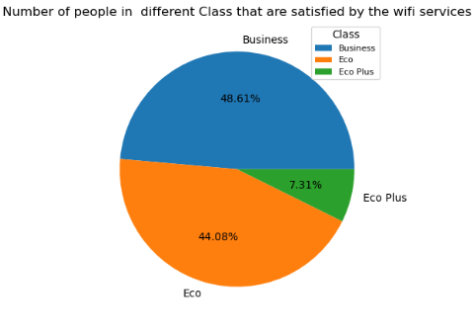
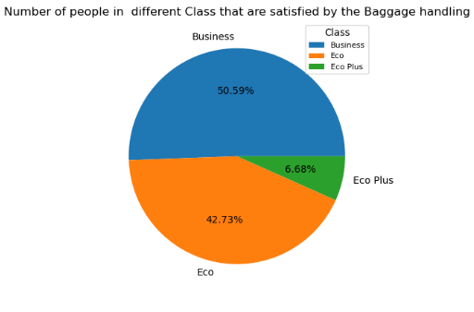
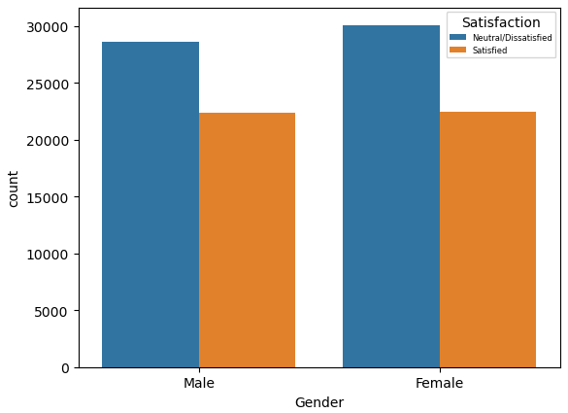
IMPLEMENTAION WITH SCREENSHOTS-1

Slide 8
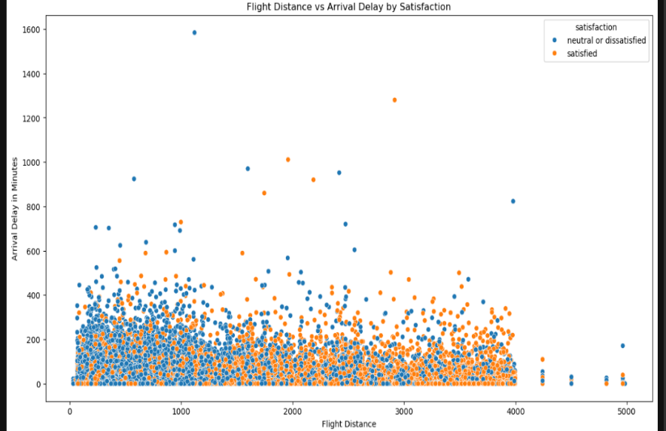
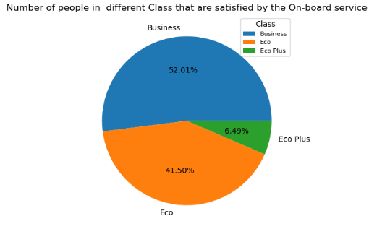
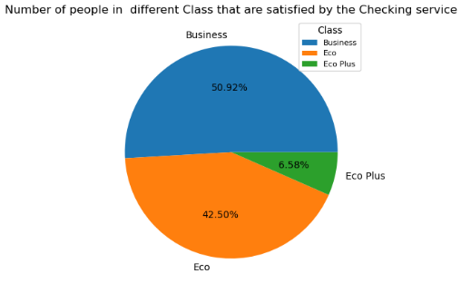
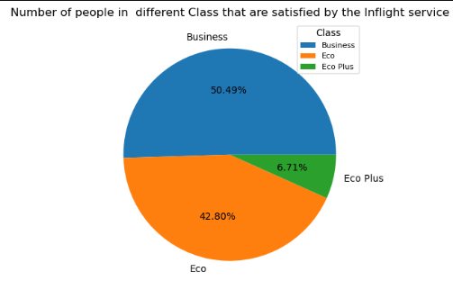
IMPLEMENTAION WITH SCREENSHOTS-2

Slide 9
CONCLUSION /FUTURE SCOPE
In the rapidly evolving aviation industry, passenger satisfaction plays a pivotal role in the success and competitiveness of airlines. By focusing on service quality, in-flight comfort, technological innovation, and customer-centric operations, airlines can significantly enhance the overall passenger experience.
The continued development of smart airports with seamless, contactless interactions—from biometric check-ins to automated baggage systems—will greatly reduce passenger friction. Implementing more efficient processes at airports will improve overall satisfaction by reducing wait times and enhancing convenience.
Future developments in in-flight entertainment (IFE) and high-speed internet connectivity will allow passengers to stay connected and entertained at all times. Airlines that can deliver seamless streaming, shopping, and communications during flights will have an advantage in passenger satisfaction.

Slide 10
BIBLIOGRAPHY
These are some of the wesites through which i get some help.
http://www.dreamincode.net/forums/topic/53926-online-examination-system-on- vbnet/
http://www.seminarprojects.com/Thread.-online-examination-project

Slide 11
THANK YOU

